Slide 1
Dengue virus
Dr.R.S.Gopika Prof &Head ,
Dept of Pathology skhmc

Slide 2
DENGUE VIRUS
family flaviviridae
Transmitted by mosquitoes
Composed of single-stranded RNA
30-45nm
Four distinct antigenically related serotypes ( 1to 4) of dengue virus

Slide 3
Dengue virus
Each serotype provides specific lifetime immunity, and short-term cross-immunity
All serotypes can cause severe and fatal disease
Serotype 2 is apparently more dangerous than other serotypes
Genetic variation within serotypes
Some genetic variants within each serotype appear to be more virulent or have greater epidemic potential

Slide 4
Vector
Aedes aegypti is the principal vector
They bite during the day time.
Aedes acquires infection by feeding on viremic patients (from a day before to 5 days later, i.e. the end of the febrile period).
Extrinsic incubation period of 8–10 days is needed before Aedesbecomes infective.
Once infected, it remains infective for life.
Aedes can pass the dengue virus to its offsprings by transovarial transmission.

Slide 5
Pathogenesis
Primary infection
Initial infection with a particular serotype is known as primary infection, which is usually asymptomatic or results in mild disease manifestations.
Secondary dengue infections
Subsequent infection due to infection with another second serotype which is different from
the first serotype causing primary infection.

Slide 6
Pathogenesis
The severity of secondary dengue infection occurs due to an immunological phenomena - antibody dependent enhancement(ADE)- the non-neutralizing antibody produced against the first serotype will combine, cover and protect the second serotype from host immune response.
ADE is remarkably observed when serotype 1 infection is followed by serotype 2, which
also claims to be the most severe form and prone to develop into DHF and DSS.

Slide 7
Pathogenesis
The virus is inoculated into humans with the mosquito saliva
The virus localizes and replicates in various organs, -local lymph nodes, liver, spleen and the thymus
The virus is then released from these tissues into the blood
Via the blood, the virus spreads throughout the body to infect other lymphatic tissues and organs, which is accompanied by symptoms

Slide 8
Clinical Classifications -2 types
The traditional (1997) WHO classification, divides dengue into three clinical stages:
Dengue Fever (DF)
Dengue Hemorrhagic Fever(DHF)
Dengue Shock Syndrome(DSS)
The 2009 WHO classification grades dengue into two stages of severity of infection:
• Dengue with or without warning signs
• Severe dengue.

Slide 9
Dengue Fever (DF):
usually affects older children and adults
Incubation period is 5 – 8 days
It is characterized by:
High fever (called as biphasic fever, break bone fever or saddle back fever)
A maculopapular rash generally appears on 3rd or 4th day
Other symptoms

Slide 10
Other symptoms
headache, retrorbital pain, conjunctival infection, pain in muscles and bones, lymphadenopathy ,loss of appetite, nausea and vomiting
The febrile illness lasts for about 10 days after which recovery is generally complete.
It is rarely fatal

Slide 11
Dengue Hemorrhagic Fever(DHF)
is characterized by:
High continuous fever
Hepatomegaly
Thrombocytopenia (platelet count < 1 Lakh/mm³
Raised hematocrit (packed cell volume) by 20%

Slide 12
Hemorrhagic Manifestations of Dengue
Skin petechiae, purpura, ecchymoses hemorrhages
Gingival bleeding
Nasal bleeding
Gastrointestinal -Hematemesis, melena,
Hematuria
Increased menstrual flow bleeding

Slide 13
Evidence of hemorrhages
which can be detected by:
▪ Positive tourniquet test
A blood pressure cuff is applied and inflated to the midpoint between the systolic and diastolic blood pressures for five minutes. The test is positive if there are more than 10 to 20 petechiae per square inch area in cubital fossa
▪ Spontaneous bleeding from skin, nose, mouth and gums

Slide 14
Dengue Shock Syndrome(DSS):
All the above criteria of DHF are present, plus
manifestations of shock

Slide 15
circulatory failure manifested by
Rapid and weak pulse
Narrow pulse pressure hypotension for age (< 20 mm
Cold, clammy skin and altered mental status
Frank shock is direct evidence of circulatory failure

Slide 16
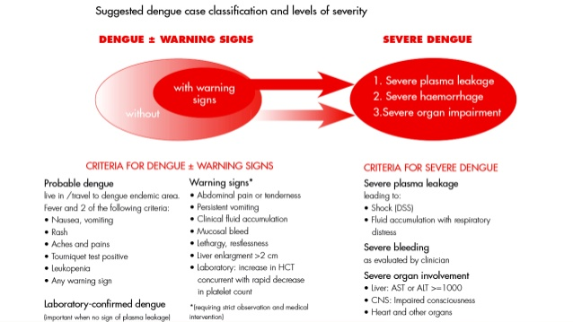

Slide 17
Laboratory diagnosis
Specimens
1) For antibody detection – serum
2) For antigen detection – serum
3) For isolation of virus and PCR
a) Serum
b) Plasma
c) Whole blood
d) Autopsy tissues
e) Mosquitoes collected in nature

Slide 18
Haematological diagnosis
Thrombocytopenia
Detection of antibody –
Demonstration of IgM antibody in serum provides early diagnosis
IgM antibody appears 5 days after onset of symptoms and persists for one to three months
Detection of four fold rise in IgG titre in sera taken at an interval of ten days or more is confirmator

Slide 19
REFERENCES
Surinder Kumar-Essentials Of Microbiology
Anandanarayanan-Text Book Of Microbiology
Apurba Sankar Sastry-Essential of Medical Microbiology
http://emergencymedic.blogspot.com/2012/06/dengue-new-who-2010-severity.html

